Slide 1
SAFe® 4.5 Executive Briefing

Slide 2
SAFe® 4.5 Release Themes
Essential SAFe and Configurability
Innovation with Lean Startup and Lean UX
Scalable DevOps and Continuous Delivery
Implementation Roadmap
And a bunch of other fairly important stuff

Slide 3
Essential SAFe and Configurability

Slide 4
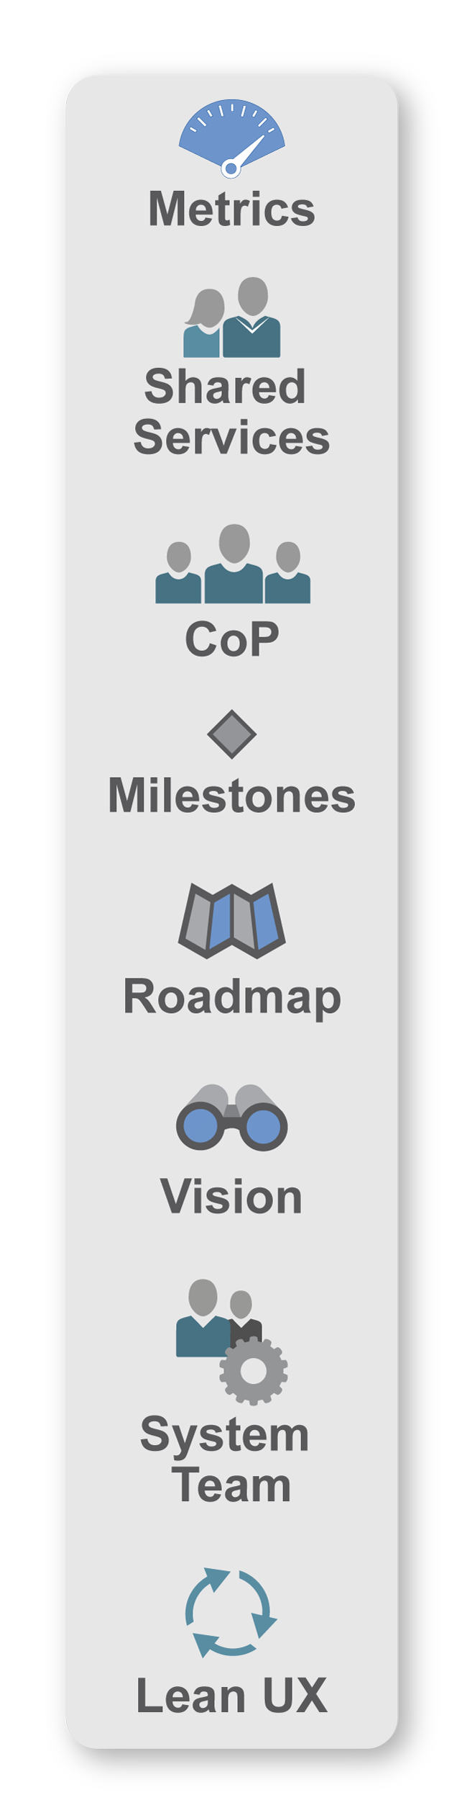
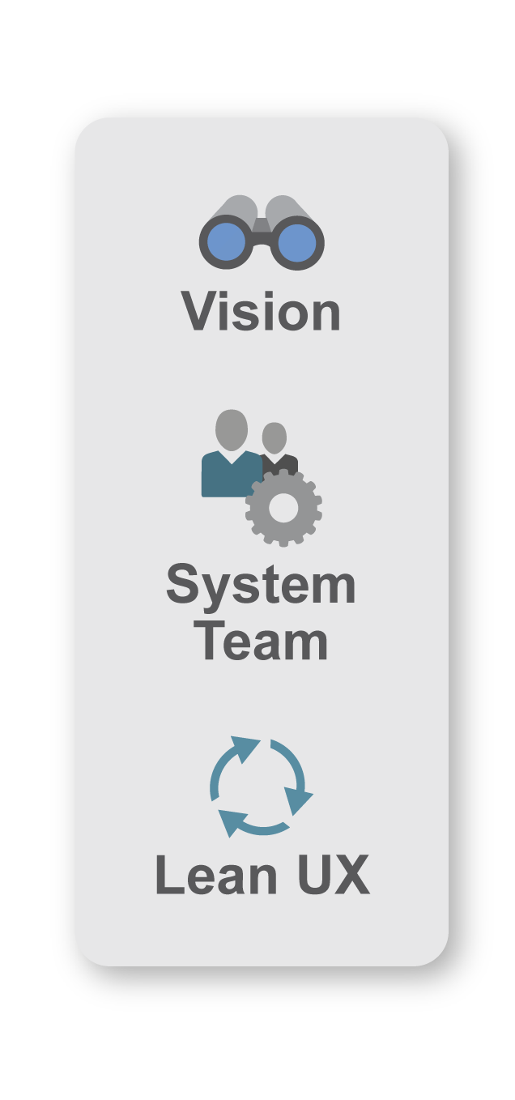
Refine configuration with Spanning Palette
Essential
SAFe
Full SAFe
Portfolio SAFe
Large Solution SAFe

Slide 5
Foster Innovation with Lean Startup, and Lean UX

Slide 6
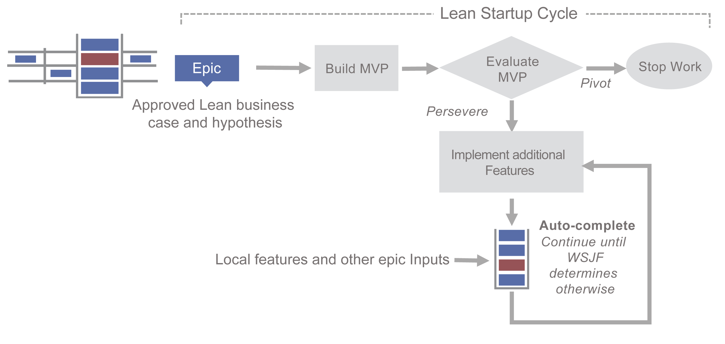
Foster Innovation with the Lean Startup Cycle
Learn more:
Ries, Eric. The Lean Startup: How Today’s Entrepreneurs Use Continuous Innovation to Create Radically Successful Businesses. Random House, Inc.

Slide 7

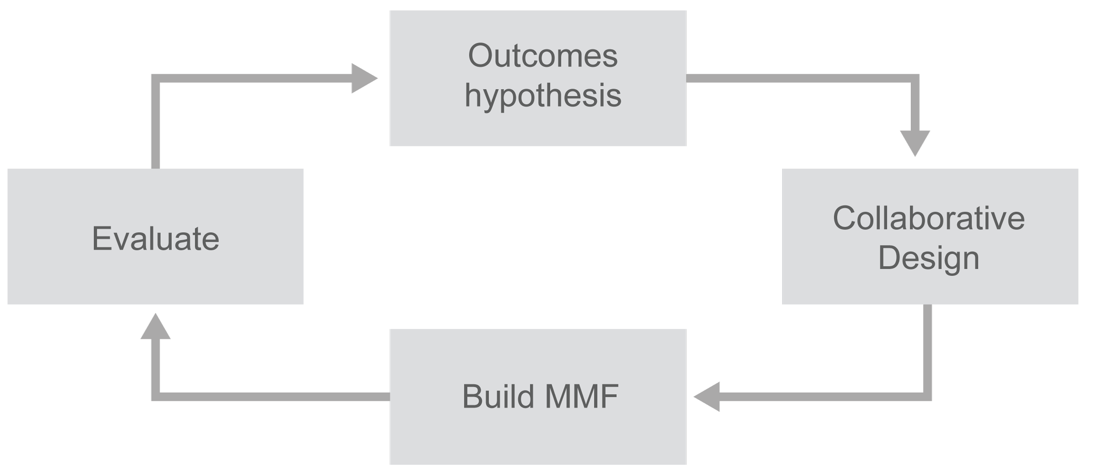
Implement features with Lean UX

Slide 8
Scalable DevOps and Continuous Delivery

Slide 9
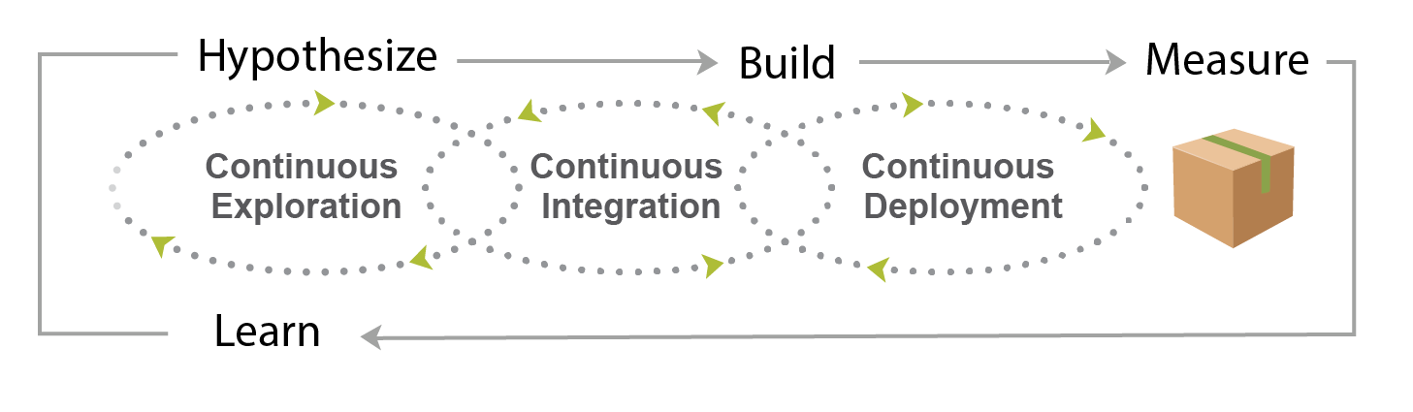
Continuing the lean journey
Hypothesize, Build, Measure, Learn

Slide 10
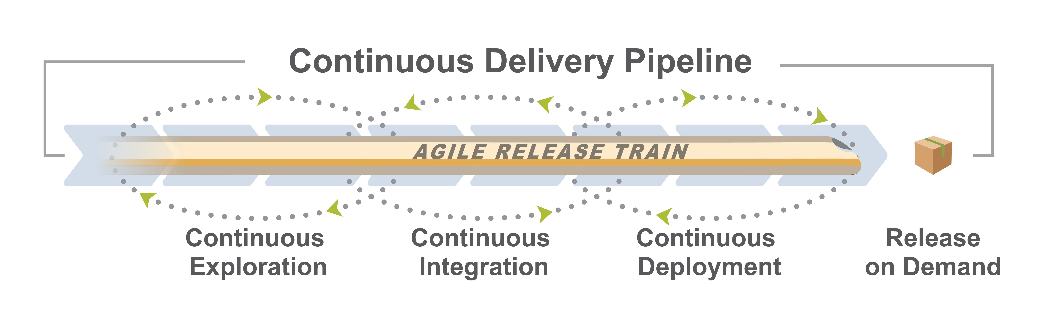
Lots of new content
New article
New article
New article
New article

Slide 11
Realize flow with a CALMR approach to DevOps
Culture
Automation
Lean flow
Measurement
Recovery

Slide 12
Visualize and manage full value Flow

Slide 13
Implementation Roadmap

Slide 14
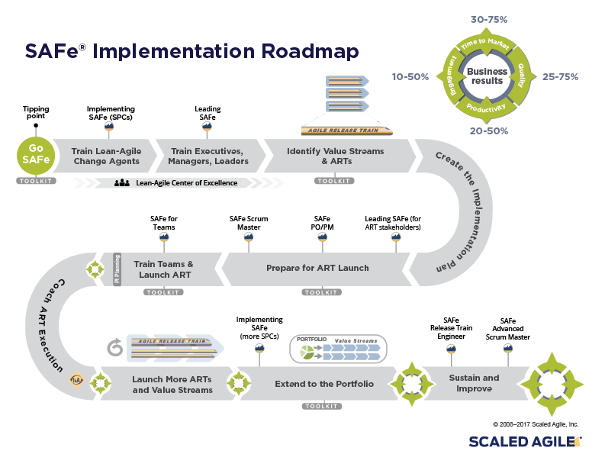
12 new articles
Links to courseware

Slide 15
An overview of some other fairly important stuff

Slide 16
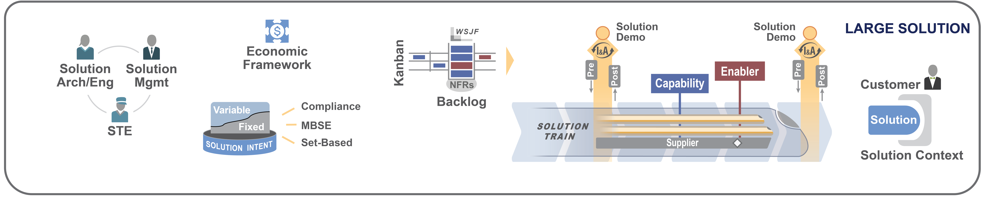
Value Stream level is now called the ‘Large Solutions’ level

Slide 17
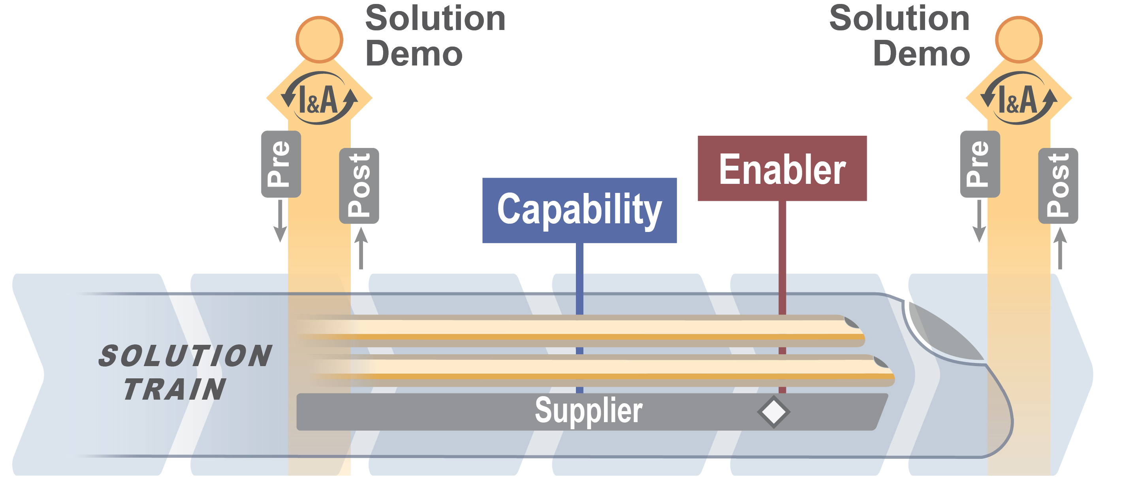
Build big systems with the new ‘Solution Train’

Slide 18
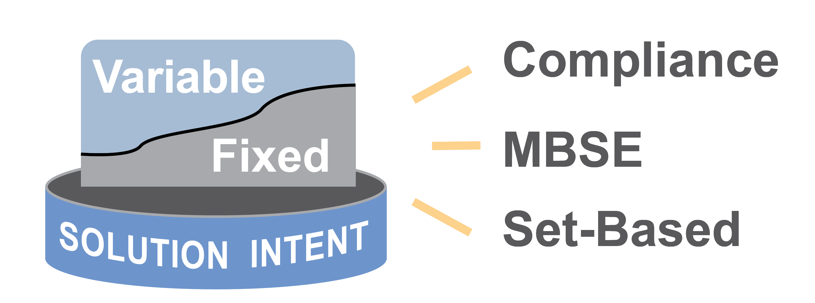
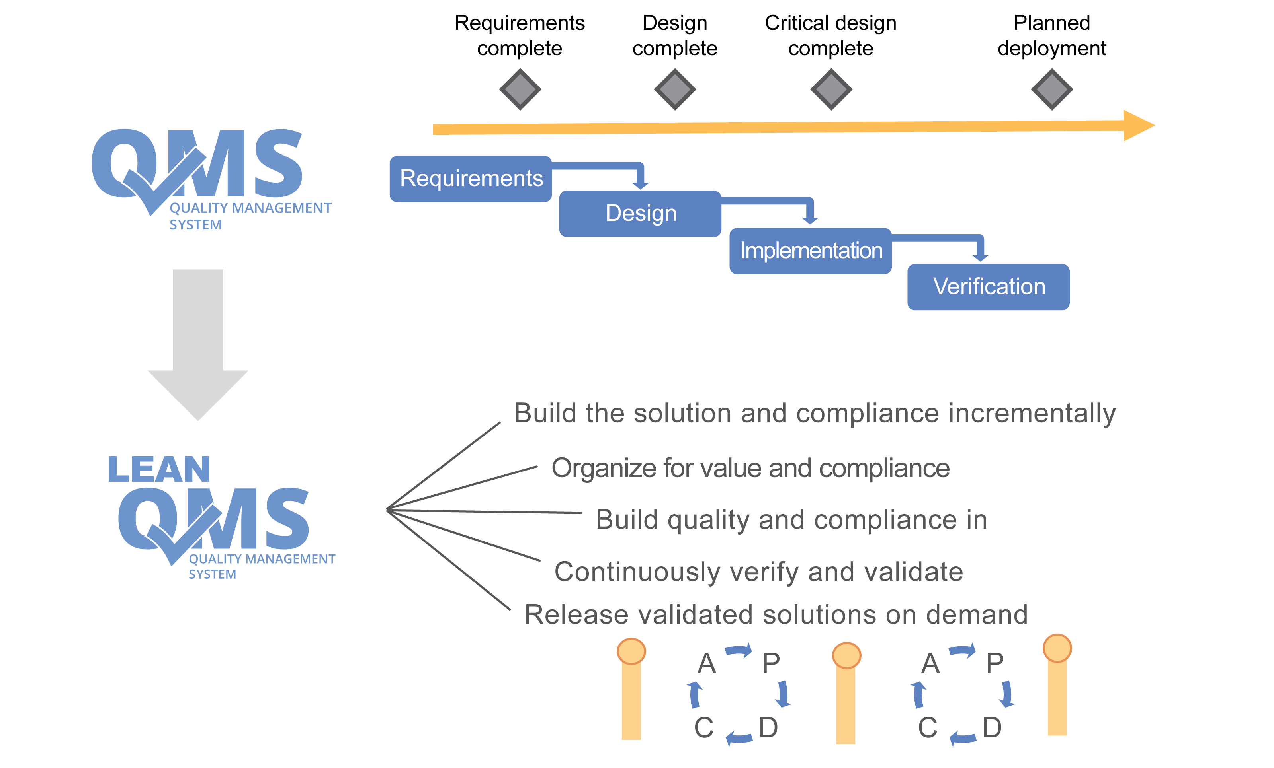
Compliance is increasingly important
New article (s)
From:
To:

Slide 19
Ready to learn more?
www.ScaledAgileFramework.com

